Slide 1
Island Sandbox
Edd Soper, Lee Lashbrook & Ben Bellenger

Slide 2
Initial Idea
Create a sand box puzzle game
4 zones
Different themes
Physics based

Slide 3
Purpose
Deliver an educational/puzzle game to children
Young mind is like a sponge when developing
Interactivity stimulates learning growth

Slide 4
Project background

Slide 5
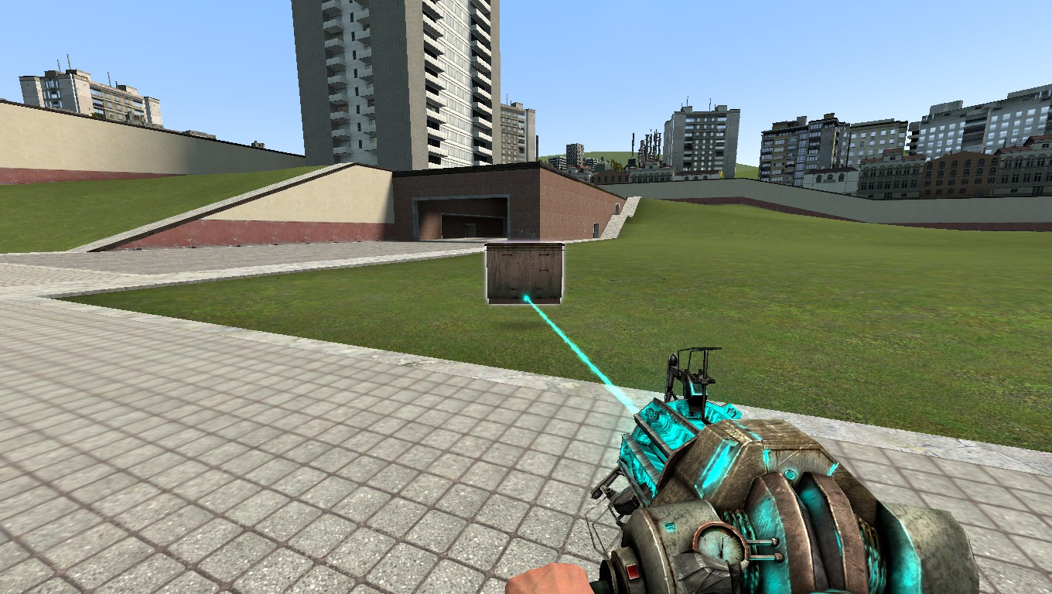
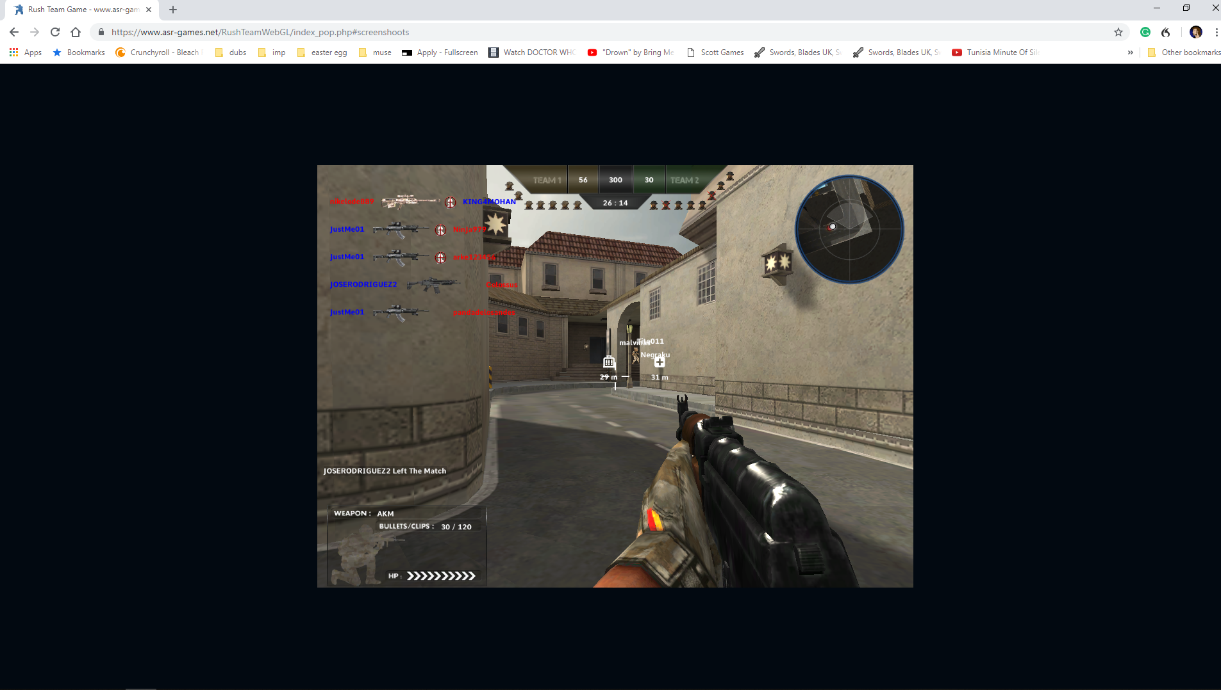
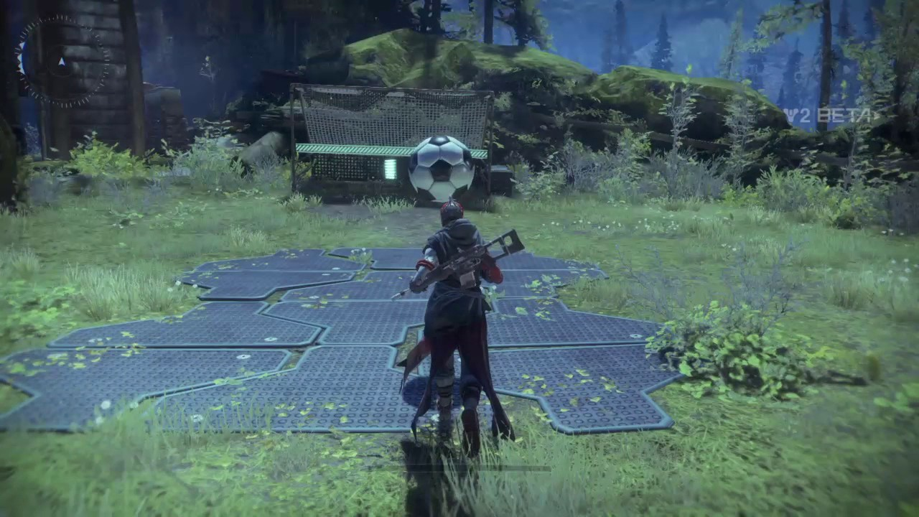
Other inspirations
Destiny 2
Gmod
Rush Team

Slide 6
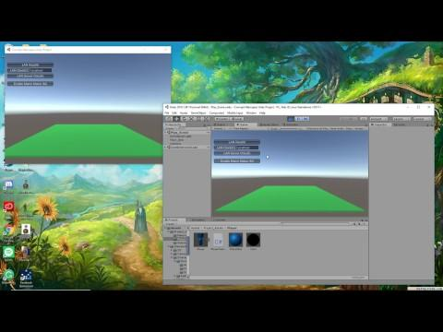
Development
Early multiplayer testing

Slide 7
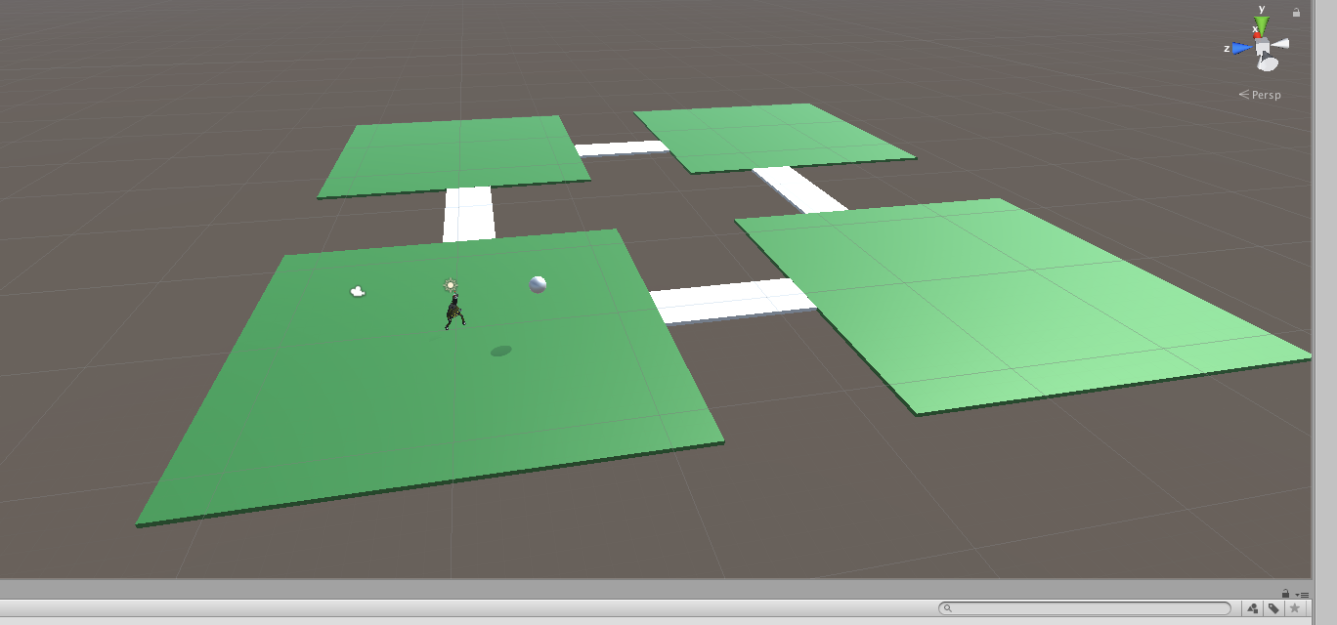
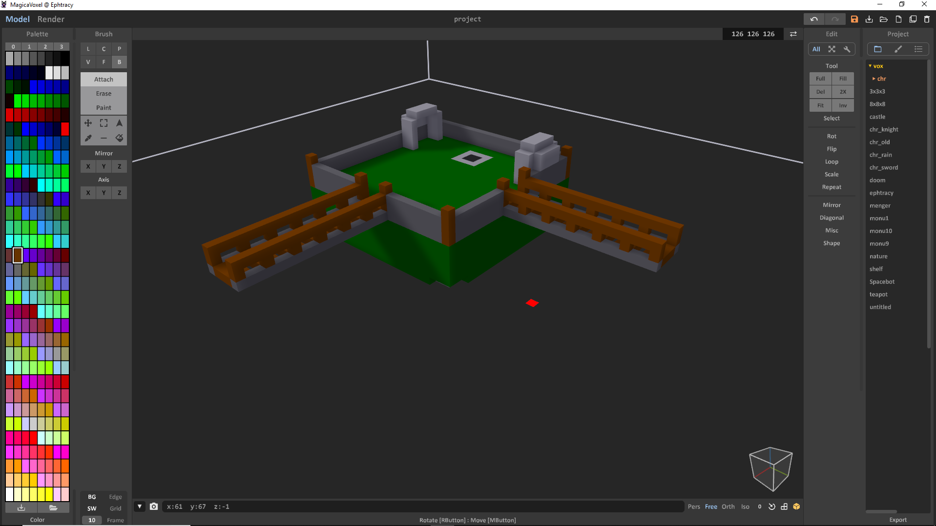
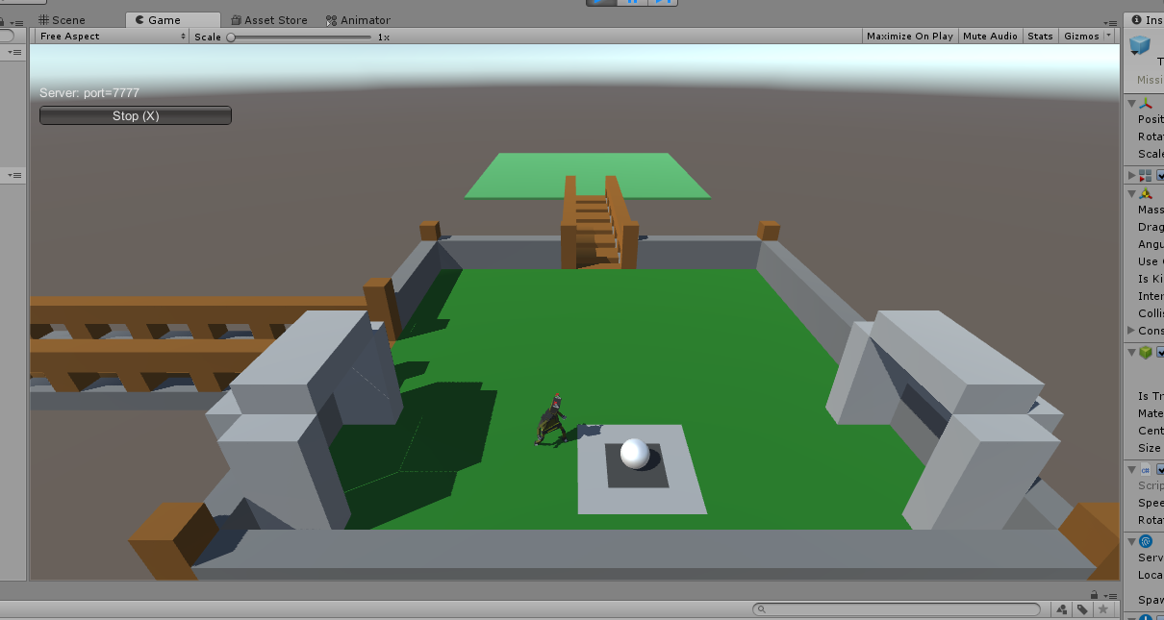
Development

Slide 8
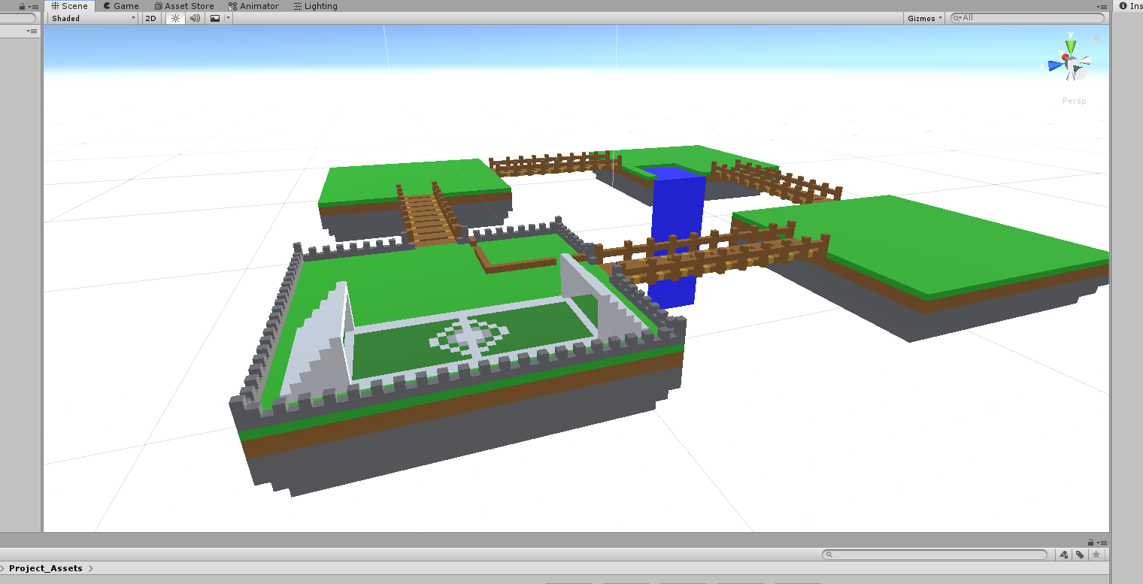
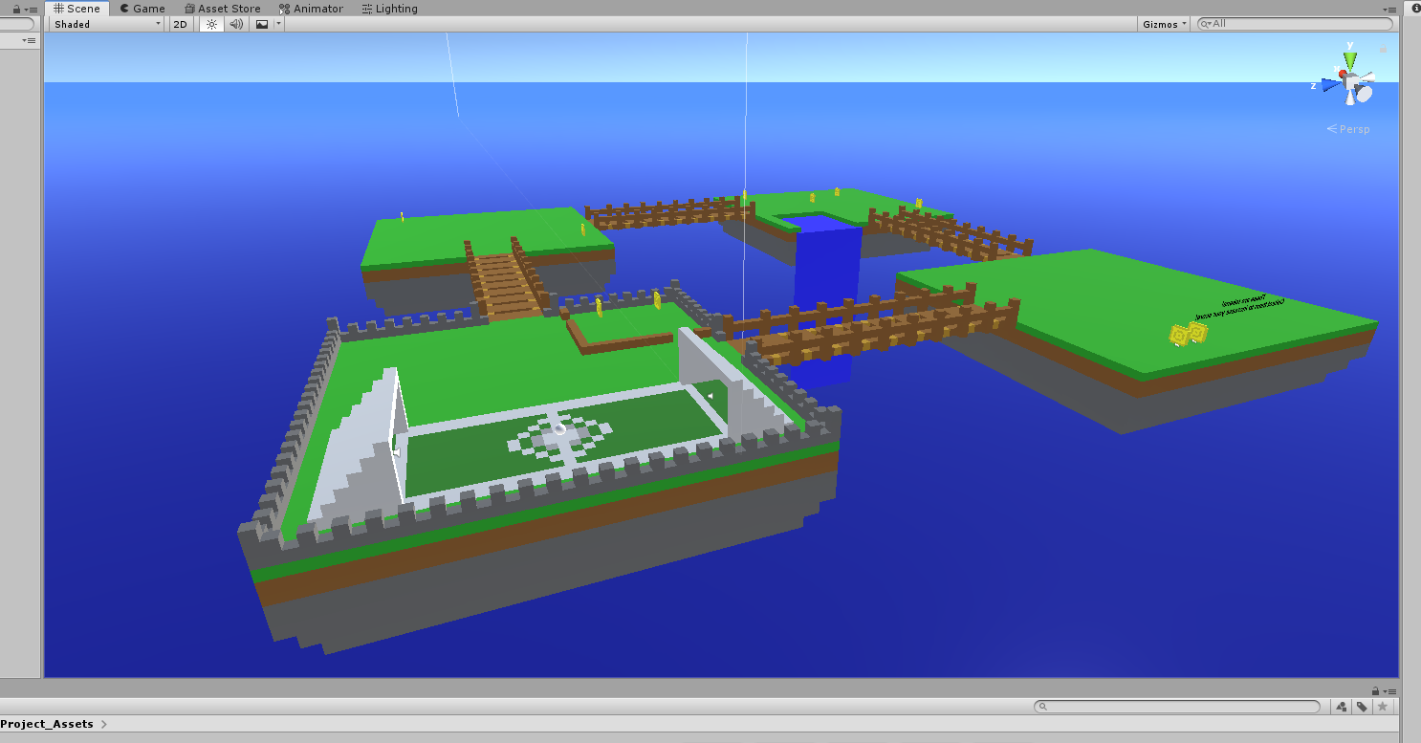
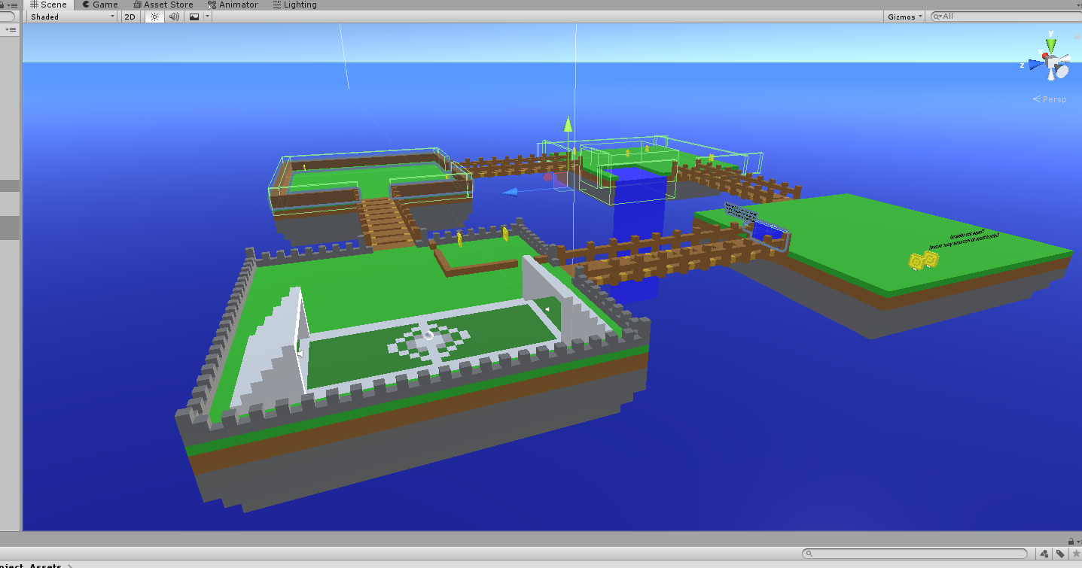
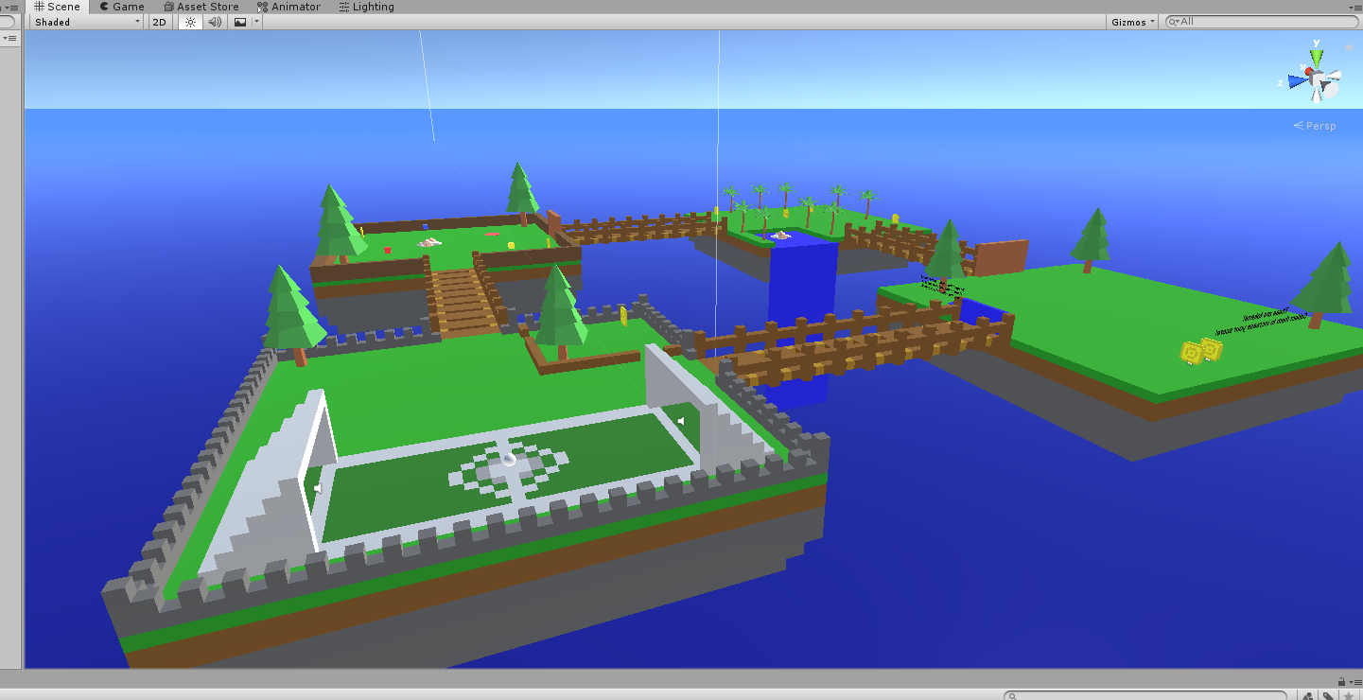
Development

Slide 9

Demonstration Video

Slide 10
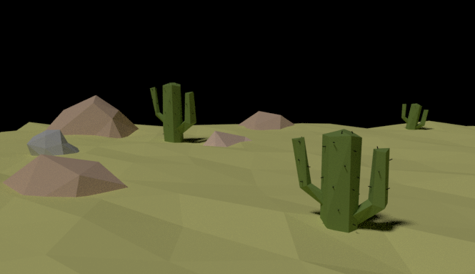
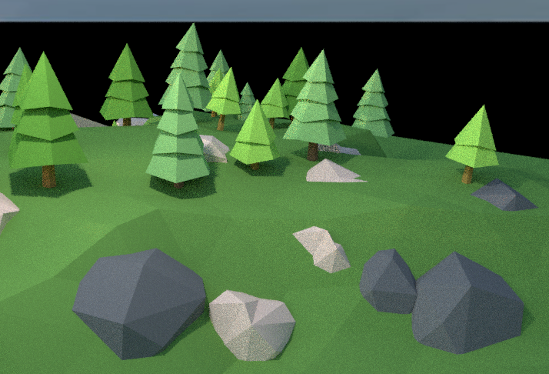
Design
We chose a low-poly art style for the project as it resembled a cartoon world. This also meant the models had a lower amount of detail which would allow the game to run smoother on less powerful computers.

Slide 11
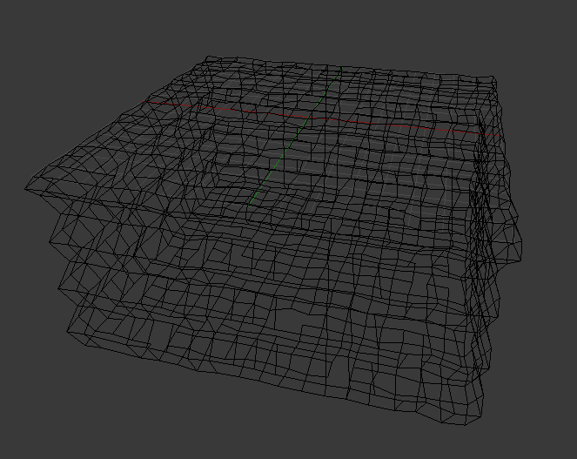
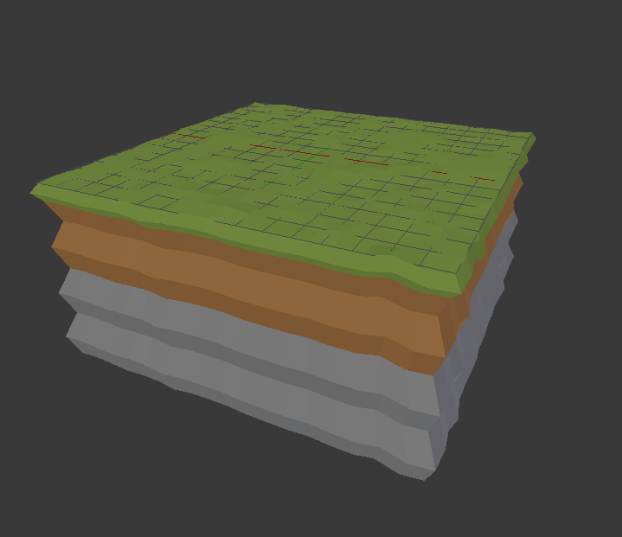
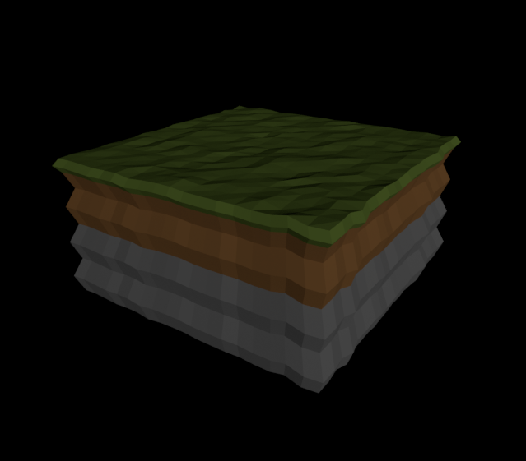
The Map
The map is designed to be modular to allow for easy expansion in the future. When a new mini-game is created it can be slotted on to the world and connected via a bridge

Slide 12
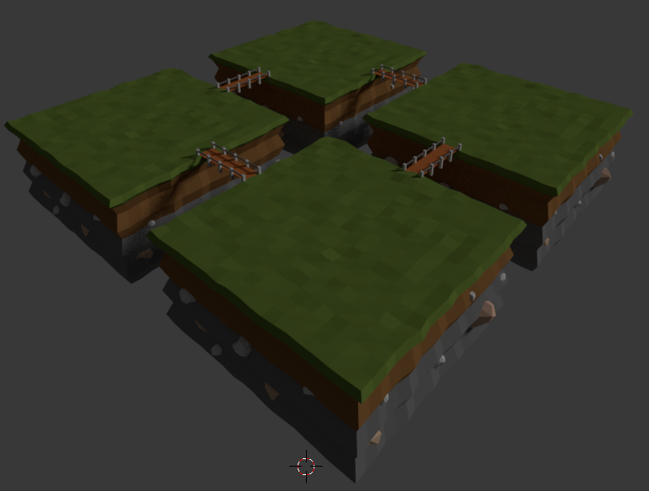
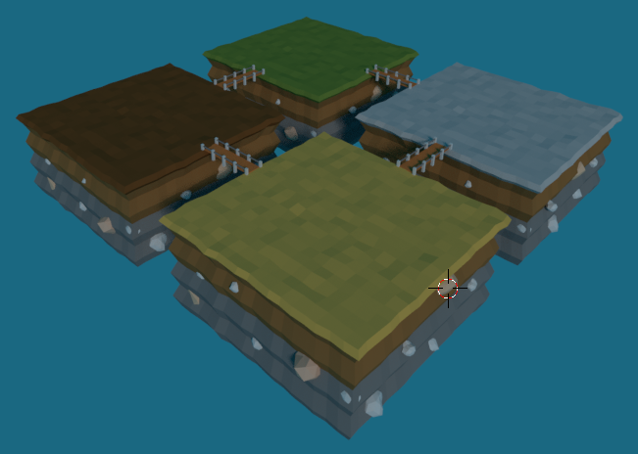
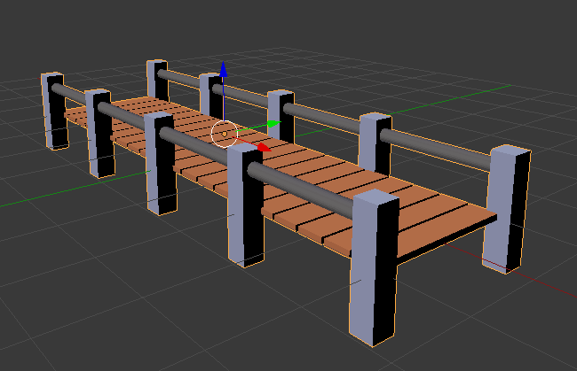

Slide 13
Questions?

